Slide 1
ITSIUG 2024
Session 48
Total Guaranteed Package (TGP)
G Saunders
A Ramji

Slide 2
INTRODUCTION
  Basic +Benefits: Notch + fixed set of benefits. Cost to the university is variable
  Staff have limited ability to structure package
  TGP Total Guaranteed Package Notch becomes total package and then benefits deducted so that annual cost to the university remains fixed
  Staff have ability to structure package.

Slide 3
UNIVERSITY REQUIRMENTS
  Staff choice to change to TGP
  Phased Approach
  Staff must be able to structure package within a set of defined rules
  Process must be as automated as possible
  Software caters for conversion to TGP
  Maintenance of Package
  New staff appointed to university

Slide 4
SOFTWARE DEVELOPMENT PROCESS
  Discussions with Adapt IT started Oct 2021
  Initial specifications and quote Feb 2022
  Quote accepted by university October 2022
  Development would require Adapt IT and university to work together
  Adapt IT would develop software to do conversion and maintenance of package for existing and new staff
  University would set up TGP appoint types on payroll.

Slide 5
SOFTWARE DEVELOPMENT PROCESS
  TGP Appointment Types setup on Test
  Software delivered for testing April -June 2023
  Testing on Test June – September 2023
  Issues identified with Bonus calculations
  Approval process
  Additional Funding obtained for bonus changes and approval process changes December 2023
  Changes due for delivery March April 2024

Slide 6
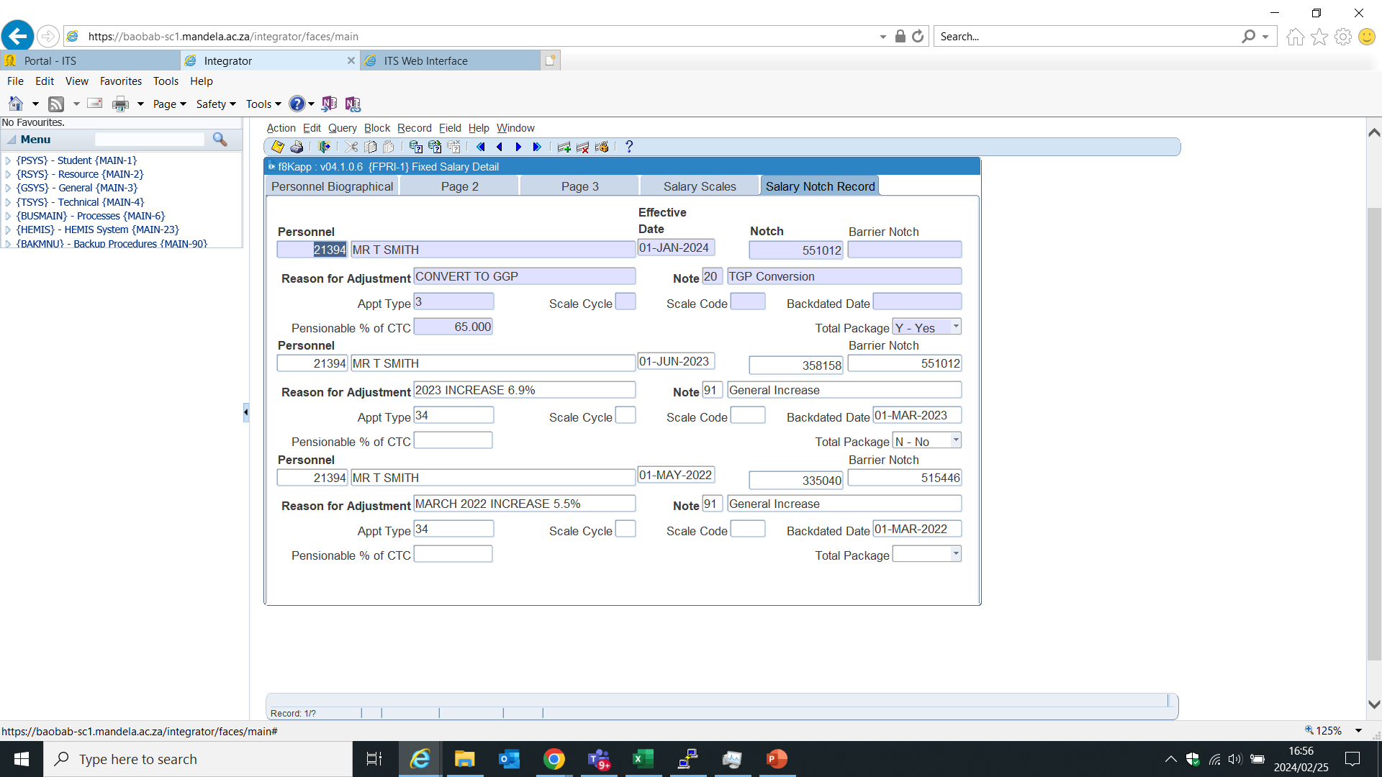
SOFTWARE CHANGES
  TGP indicator on Appointment Type (PACS-1)
  TGP Package indicator on Notch Screen and % Pensionable on CTC field. (FPRI-1)

Slide 7
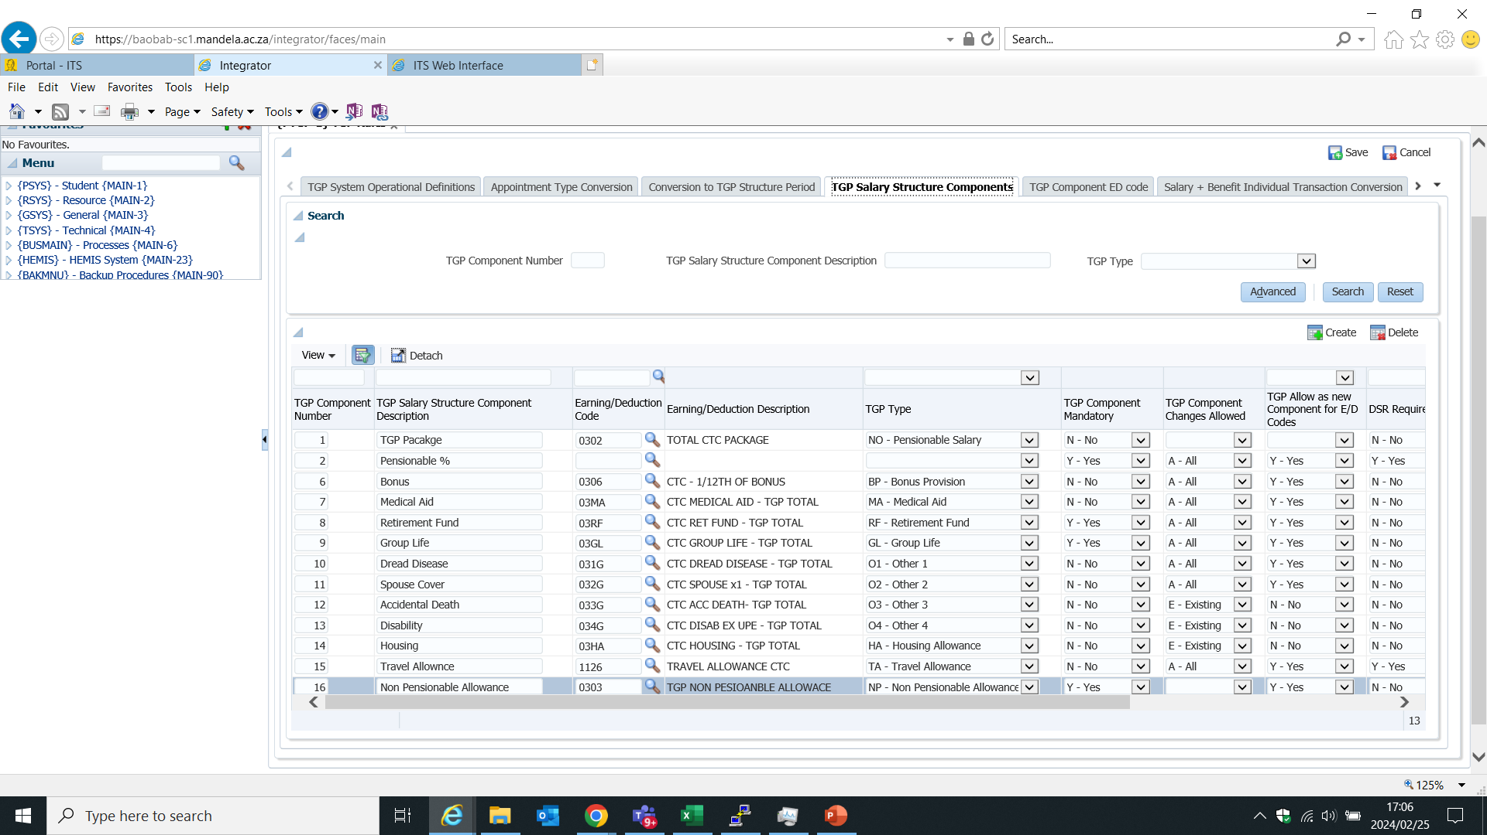
SOFTWARE CHAGES (PTGP-1)
  Form to specify TGP conversion rules
  8 Tab set of rules to mange process

Slide 8
i ENABLER OPTIONS
  In Confidential Detail Uses Renumeration PIN
  HR can convert on behalf of staff member
  Staff member accepts calculation
  Goes though approval process (To be changed)
  Once Approved loaded into Backoffice HR and Payroll.

Slide 9
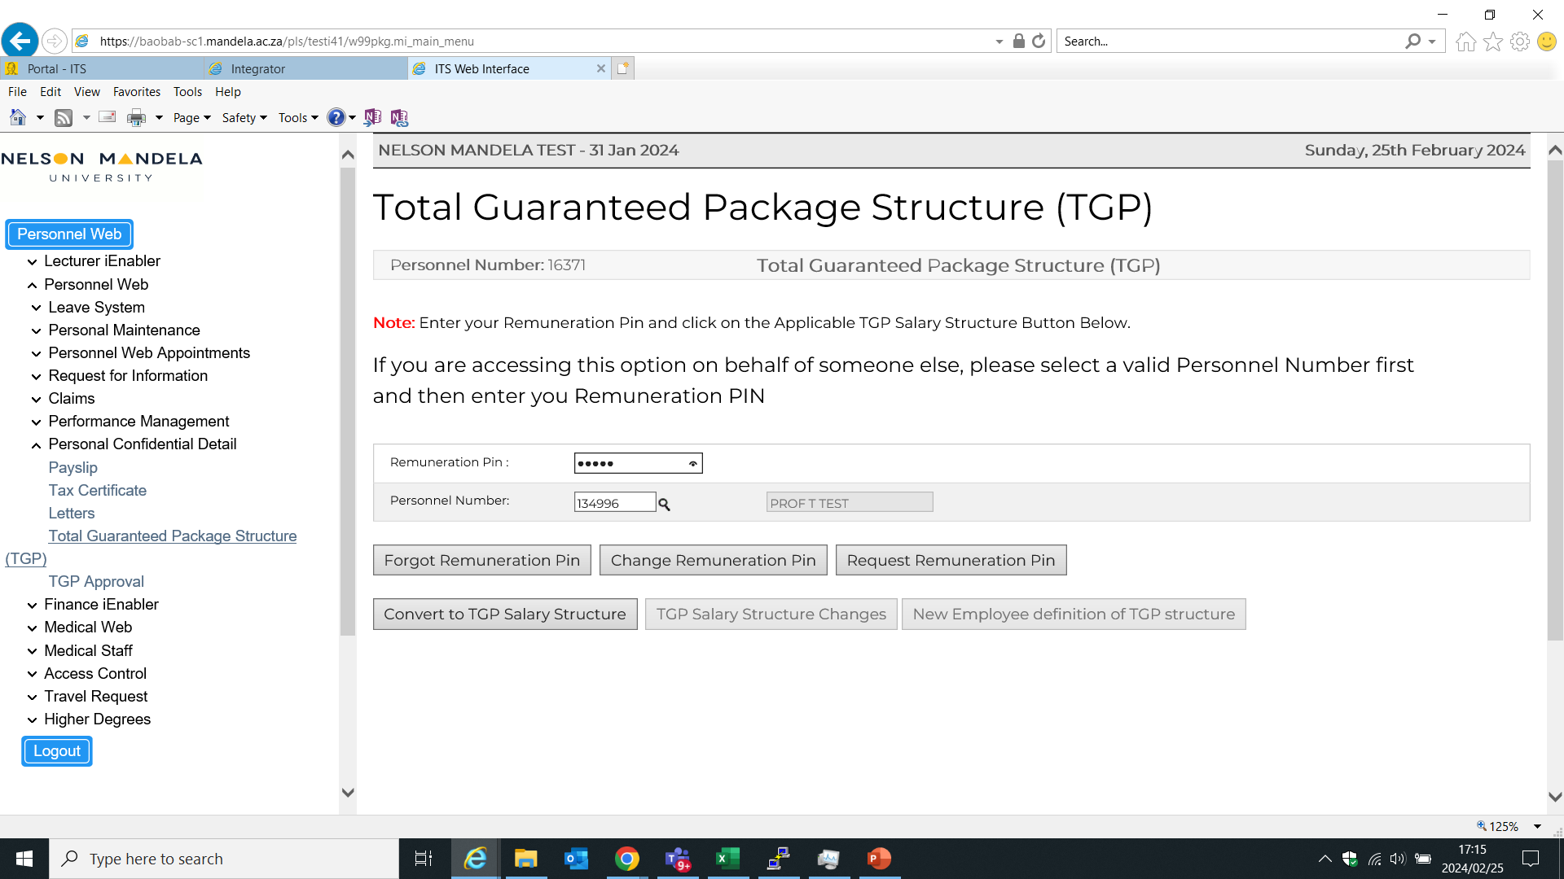
i ENABLER OPTIONS
  Convert to TGP (Screen 1)

Slide 10
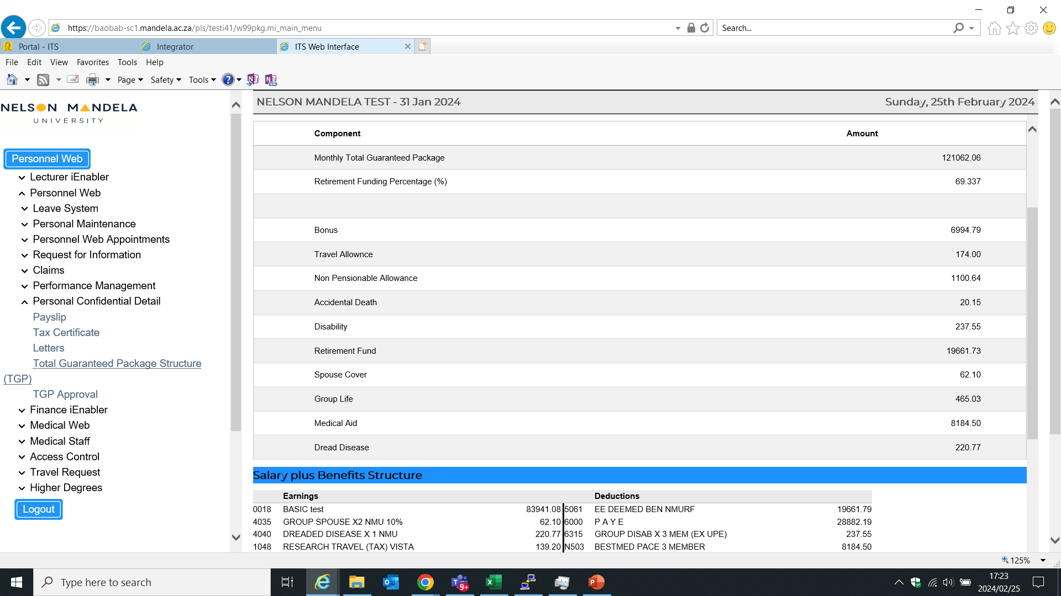
i ENABLER OPTIONS
  Convert to TGP (Screen 2)

Slide 11
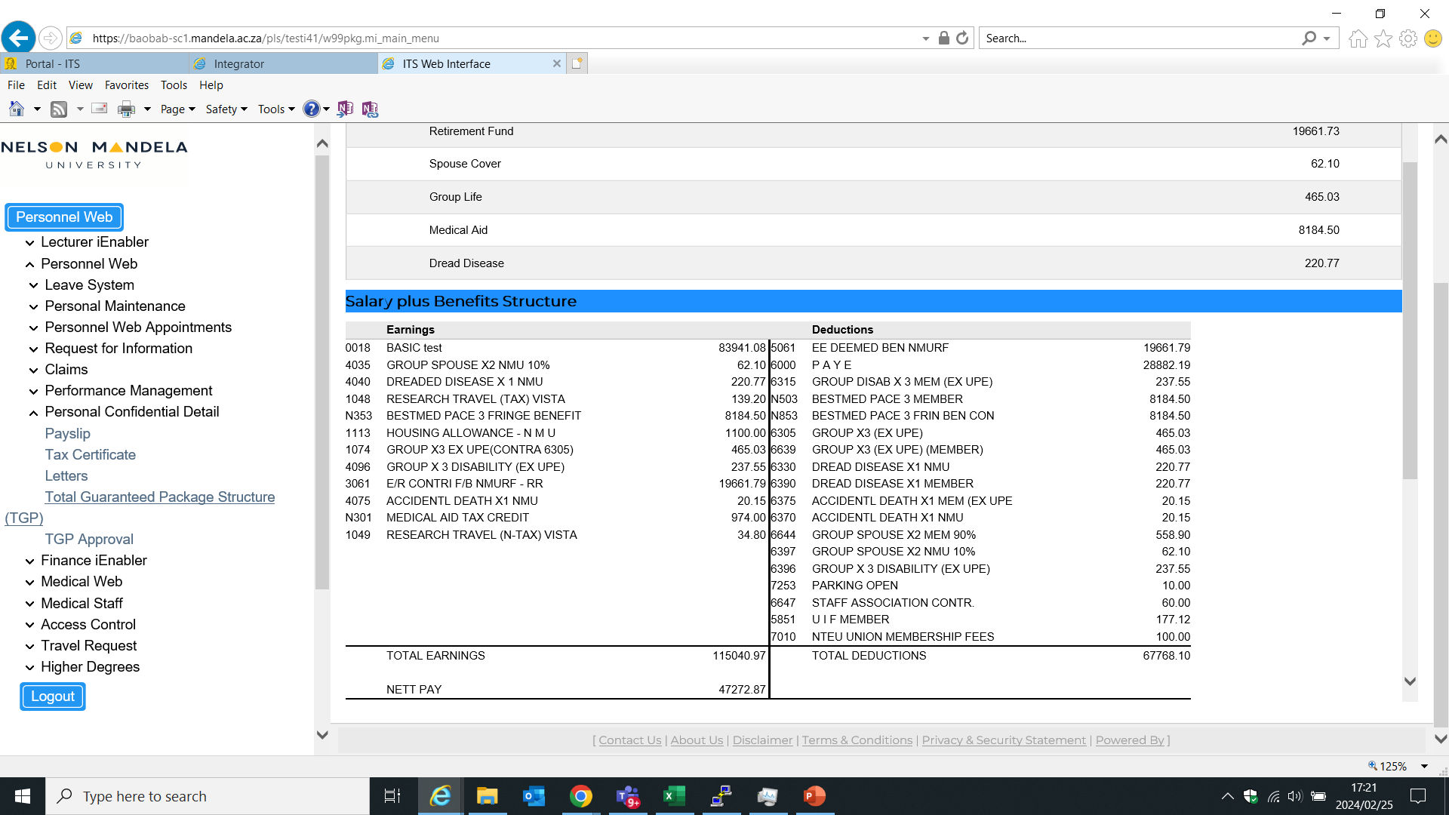
i ENABLER OPTIONS
  Convert to TGP (Screen 3)

Slide 12
i ENABLER OPTIONS
  Convert to TGP (Screen 4)

Slide 13
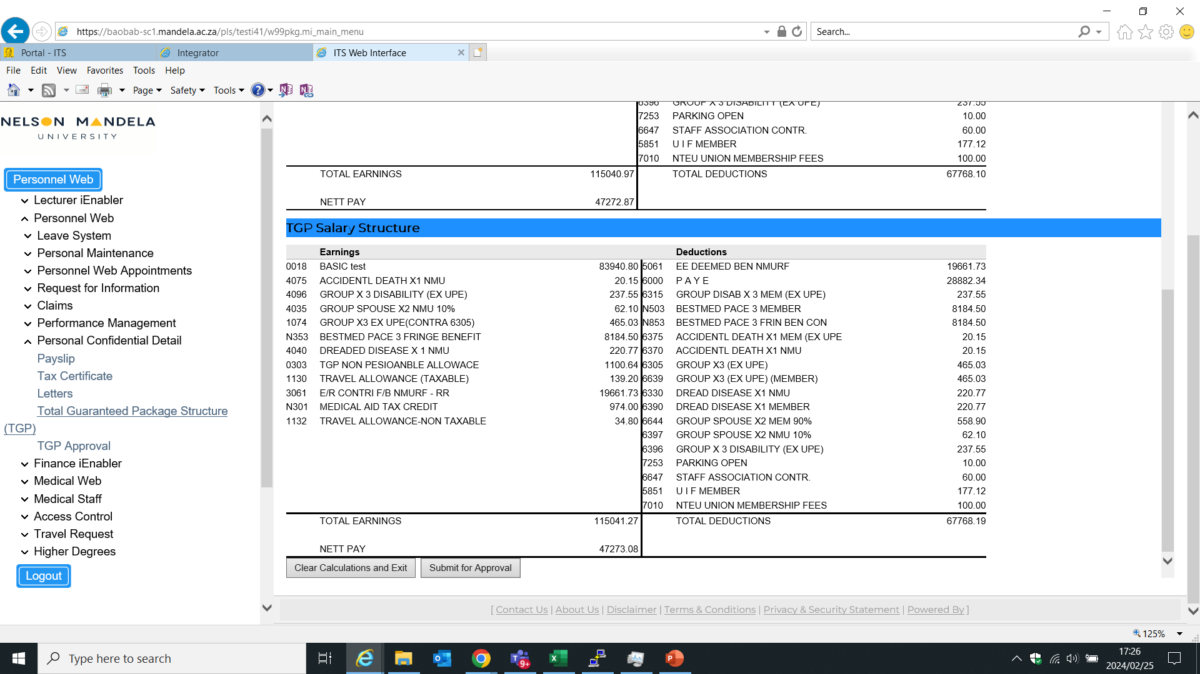
i ENABLER OPTIONS
  Convert to TGP (Screen 5)

Slide 14
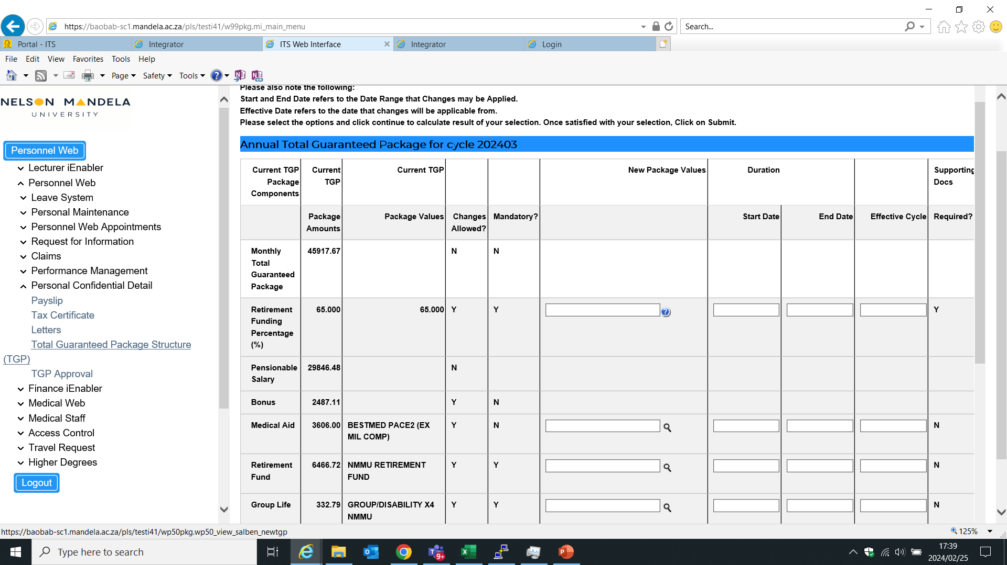
i ENABLER OPTIONS
  Maintain TGP Package (New Staff Similar Scr 1)

Slide 15
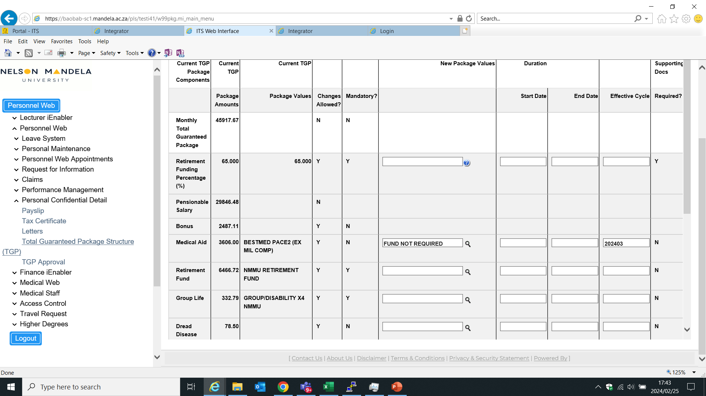
i ENABLER OPTIONS
  Maintain TGP Package (New Staff Similar Scr 2)

Slide 16
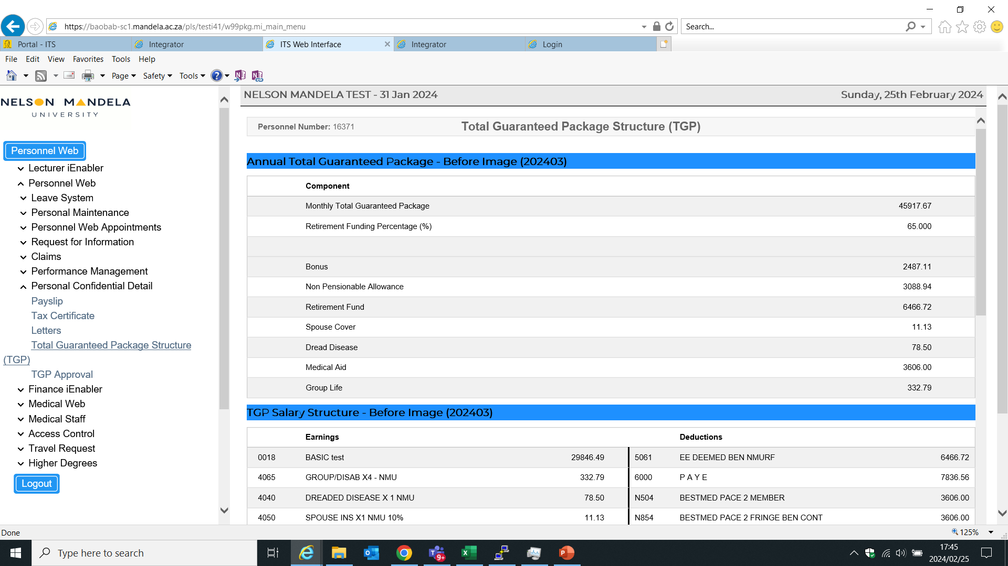
i ENABLER OPTIONS
  Maintain TGP Package (New Staff Similar Scr 3)

Slide 17
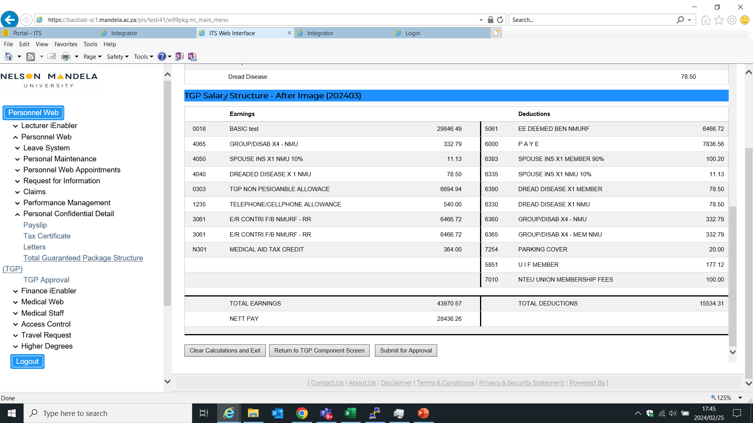
i ENABLER OPTIONS
  Maintain TGP Package (New Staff Similar Scr 4)

Slide 18
WAY FORWARD
  Complete Bonus and Approval Changes
  Reset Process
  Get Clarity on all TGP Rules
  Setup Production
  Lessons Learnt
  Do not underestimate costs or time
  Proper Project Management Needed
  Buy in from all stakeholders

Slide 19
www.mandela.ac.za

